Slide 1

A short Presentation, celebrating black history month.
Welcome to

Slide 2
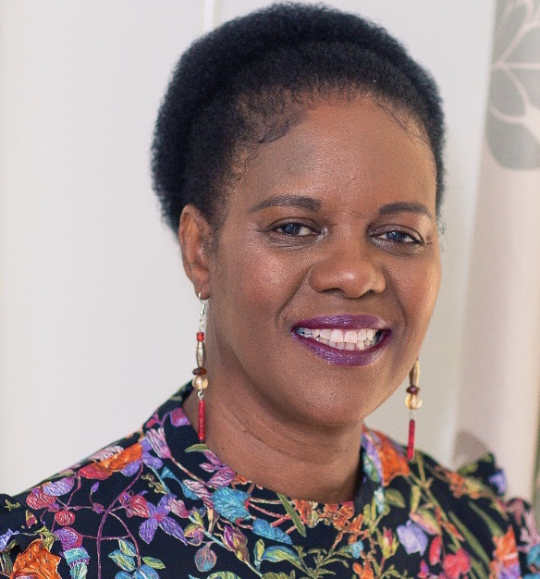
My name is Cherry, the coordinator for the charity Blacklivesmentored

Slide 3

Presenting:
What is Blacklivesmentored
Mission statement
Our Team
What is a mentor
Contact details

Slide 4
What is Blacklivesmentored
Blacklivesmentored is a registered charity in association with Black Lives Matter. The charity has a speciality in acute mental health disorders. It was founded during the pandemic to support the Black, Minority Ethnic community.
The goal is to invite people into meaningful, honest and reflective conversations where they can be listened to and given an outside perspective to their worries.

Slide 5
The mission of Blacklivesmentored charity is to empower all those we provide a mentoring service to, enable them to realise their full potential and beyond by facilitating mentoring relationships
Providing opportunities for reflection, self-examination and teaching practical skills that helps to strengthen, self-confidence, find their voice, learn to employ influence, exercising independence and articulating their goals.
Mission statement

Slide 6
The Team
Earl Douse Director
Dr Richard Oliphant
Assistant Director
Ade Kinoshi
Trustee
Eythan Bell
Trustee
Keisha Brown
Trustee
Whitney Douse
Trustee
Sharon Douse
Coordinator
Shaun Tulloch
Board member
Sonia Friouzi
Board member
Tambudzai Ndlovu
Board member
Michael Allen
Board member
Teamwork makes the dream work

Slide 7
Blacklivesmentored believes the characteristics of a good mentor is:
Professional
Approachable
Supporting
Good listener and trustworthy
Patient and friendly

Slide 8
Mentoring
MENTORING ALLOWS US TO ADAPT
It allows us to connect with people and improve their knowledge, skills, values and social mobility.

Slide 9


Contact us…..
Websites: www.Blacklivesmentored.com
Phone: (07837) 215194
Instagram: Blacklivesmentored
Linkedin: Blacklivesmentored
Donations to the charity are welcome
at Blacklivesmentored Limited
Sort code: 04-06-05
Account: 13916997

