Slide 1

A short Presentation.
A registered charity providing a mentor service with a speciality in mental health
support for Black Minority Ethnic communities
04/05/2024

Slide 2
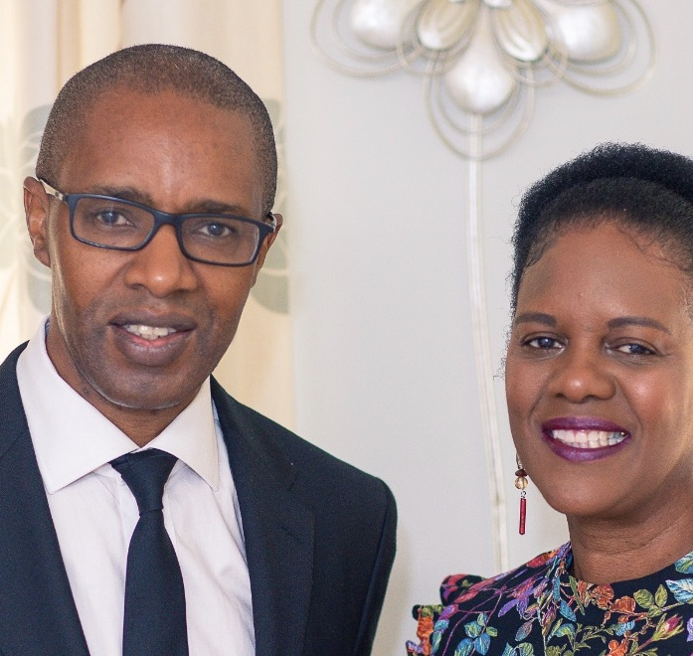
Blacklivesmentored,
This is a mentoring service specialising in mentoring BME clients.
Welcome and Introduction to Blacklivesmentored
Brief Overview of Presentation Structure
The Executive Board comprises :
Founder: Earl Douse,
Trustees: Ade Kinoshi, Whitney Douse, Eythan Bell,
Coordinator: Sharon Douse
Keisha Brown, Michael Allen, Dr Richard Oliphant,
Shaun Tulloch, Sonia Friouzi, Tambudzai Ndlovu.

Slide 3
2. How Did I Come to Faith?
Personal Journey to Faith
Influential Factors and Experiences
My testimony, stretching back over 40 years of walking with the Lord

Slide 4
3. Impact of Faith on My Work
Integration of Faith and Action
Guiding Principles and Values
…."And now abideth faith, hope, charity, these three; but the greatest of these is charity.” √ "charity" is often replaced with "love," hence the commonly quoted phrase, "the greatest is love."

Slide 5
4. Understanding Our Ministry
Definition and Scope of Blacklivesmentored
Our Vision and Purpose
Our vision is to empower individuals to achieve their full potential by
helping them shift their focus towards their goals. We are committed to providing
the support and guidance needed to make meaningful and lasting changes in their lives.

Slide 6
5: Path to Current Ministry
Factors and Motivations Leading to Blacklivesmentored
Turning Points and Inspirations
merciless murder of 46-yearold George Floyd at the hands of the police.
The news sparked a global outcry and movement amongst the black community
to bring immediate visibility to the plight of black people.

Slide 7
6: Addressing Critical Needs
Identifying the Gap: What Need Does Blacklivesmentored Fulfill?
Contextualizing the Significance of Our Work

Slide 8
7: The Necessity of Our Mission
Understanding the Scale of the Issue/Need
Justification for Intervention: Why Blacklivesmentored Matters

Slide 9
8: Impact Assessment
Measuring Success: Tangible and Intangible Outcomes
Stories of Change: Real-life Examples

Slide 10
9: Challenges Faced
Identifying and Overcoming Obstacles
Lessons Learned and Strategies for Resilience
Next two slides show a table format of the challenges faced by Blacklivesmentored and the
corresponding strategies employed to overcome them and foster resilience within the organization.

Slide 11
Challenges Faced and Strategies for Resilience
Challenges Faced | Overcoming Obstacles, Lessons Learned, and Strategies for Resilience
Lack of Funding | - Creative Fundraising Initiatives
 | - Building Strategic Partnerships
 | - Grant Applications and Donor Cultivation
 | - Leveraging Volunteer Networks and Community Support
 | - Diversifying Revenue Streams
 | - Impactful Communication: Articulating the Need and Impact to Potential Donors and Supporters
Limited Resources and Capacity | - Efficient Resource Allocation: Prioritizing Needs and Maximizing Impact
 | - Volunteer Recruitment and Retention
 | - Capacity Building: Training and Developing Team Members
 | - Collaborative Partnerships: Sharing Resources and Expertise
 | - Strategic Planning: Setting Realistic Goals and Milestones
 | - Empowering Leadership: Delegating Responsibilities and Encouraging Innovation

Slide 12
Challenges Faced and Strategies for Resilience
Resistance to Change and Stigma | - Education and Awareness Campaigns: Dispelling Myths and Challenging Stereotypes
 | - Community Engagement: Building Trust and Fostering Dialogue
 | - Advocacy and Policy Influence: Effecting Systemic Change
 | - Cultural Competency Training: Understanding and Respecting Diverse Perspectives
 | - Personal Resilience: Self-care Practices and Mental Health Support
 | - Building Coalitions: Uniting with Like-minded Organizations for Collective Impact
Burnout and Compassion Fatigue | - Self-care Strategies: Prioritizing Well-being and Setting Boundaries
 | - Peer Support Networks: Sharing Experiences and Providing Emotional Support
 | - Professional Development: Building Skills and Resilience through Training and Mentorship
 | - Recognition and Appreciation: Celebrating Achievements and Acknowledging Contributions
 | - Work-Life Balance: Establishing Healthy Boundaries and Finding Joy Outside of Work
 | - Reflective Practice: Learning from Challenges and Embracing Growth Opportunities

Slide 13
10: Additional Information
Referral System: How to Access Blacklivesmentored Services
Upcoming Events and Community Engagements
Fundraising Initiatives: Opportunities for Support and Involvement

Slide 14
Here's a visual representation of the referral system for Blacklivesmentored:
Referrer visits the charity's website and navigates to the "Our Clients" then "Contact” section.
Referrer downloads the referral document from the "Contact" page and completes it.
Referrer returns the completed document to support@blacklivesmentored.com.
Coordinator receives and reviews the referral.
Coordinator contacts both the referrer and the client to discuss concerns and gather additional information.
6. Assessment is conducted to determine the needs and preferences of the client.
7. Matching process begins, which takes approximately two weeks.
8. Coordinator contacts the appropriate volunteer mentor and arranges for mentoring to begin.
9. Mentoring sessions are carried out remotely, typically one hour per week for four weeks.
10. Mentor sends session notes to the coordinator after each session.
11. After completing all sessions, a review is conducted to evaluate progress and determine the final outcome.

Slide 15
Conclusion
Recap of Key Points
Call to Action: Join Us in Empowering Change

Slide 16

Conclusion and Call to Action
Thank you for joining us on this journey through Blacklivesmentored. Let's recap the key points:
Thank you for joining us on this journey through Blacklivesmentored. Let's recap the key points:
Mission: Empowering change through mentorship and support.
Referral Process: Visit our website, download the referral document, and submit it to support@blacklivesmentored.com. Our team will review and initiate the matching process.
Mentoring Journey: From assessment to remote sessions, our dedicated volunteers provide support and guidance every step of the way.
Impact: Together, we're making a difference in the lives of those we serve, fostering resilience and empowerment.

Slide 17
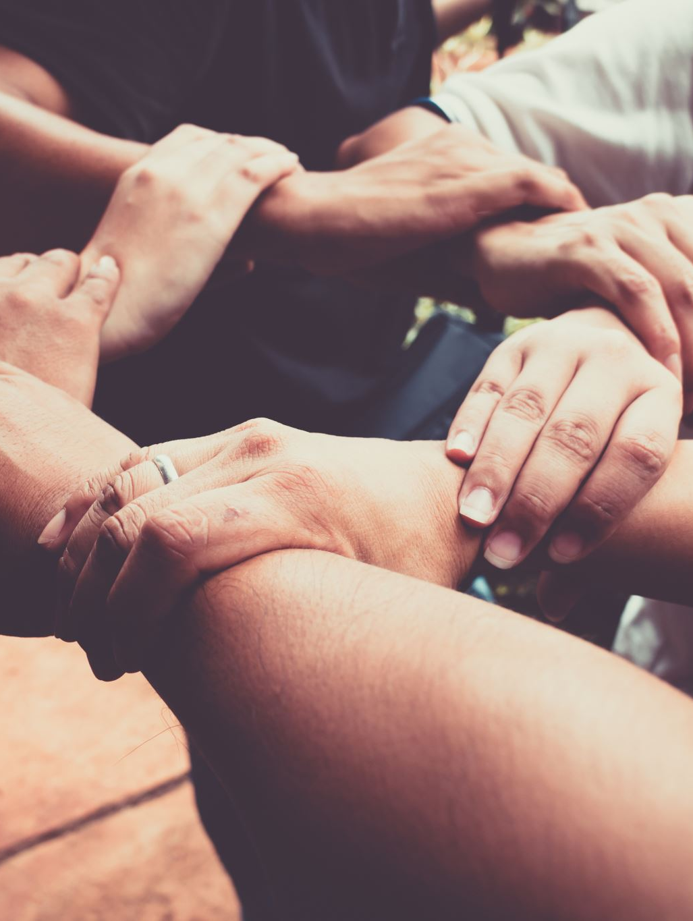
Now, we invite you to take action:
Join Us: Whether as a volunteer mentor, donor, or advocate, your involvement is crucial to our mission's success.
Empower Change: Together, we can create a brighter future for individuals and communities alike.
Let's continue to stand together in solidarity, empowering change and building a more inclusive and supportive society for all. Thank you for your support and commitment to making a difference with Blacklivesmentored.

Slide 18

Blacklivesmentored Achievements:
- Mentorship provided to:
- Children struggling at school
- Employed men with low self-esteem
- Students diagnosed with long COVID
- Older adults suffering from the effects of long COVID
- Females diagnosed with depression
- Children from mixed heritage struggling with issues of identity
- Adult males being bullied and racially abused at work
- Young men and women needing social direction
- Support with private tutoring fees for underachieving young boys
- And many more...

Slide 19
: Q&A
Open Floor for Questions and Discussion

Slide 20
You can contact us via…
Through our mentoring service we provide knowledge, skills and values to enable individuals from BME backgrounds to improve their social mobility.
Websites: www.Blacklivesmentored.com
(Here you can make a referral)
Email: Support@Blacklivesmentored.com
Phone: (07837) 215194
Instagram: Blacklivesmentored
Linkedin: Blacklivesmentored
What we need from you is:
Your support
We have some cards and leaflets at the info point.
Donations to the charity are welcome
Account: Black Lives Mentored
Sort code: 00-92-99
Account: 67353240-00

